Slide 1

CSA0203- C PROGRAMMING
Smart Farm Monitoring System Using C
Student Names:
R. Jaideep(192525441)
B. Bhanu Prakash(192412518)
P. Jeevan Kumar(192572090)
Guided By:
Dr.Saravanan Kaliaperumal

Slide 2


Introduction
Smart Farm Monitoring
Modern farms use multiple sensor nodes for monitoring.
Sensors measure:
Soil Moisture
Temperature
Humidity
Water Level
Sensor data is periodically sent to a central monitoring system.
The number of sensors can increase dynamically.

Slide 3
Problem Statement & Objectives
Large agricultural farms contain hundreds of sensors. Manually monitoring all sensors is difficult, especially when sensors become inactive or stop sending data.
Objectives
Dynamically register sensor nodes.
Manage sensor information using pointers.
Analyse sensor readings using C functions.
Organize farm hierarchy using recursion.
Store historical sensor readings.
Detect inactive sensors.

Slide 4
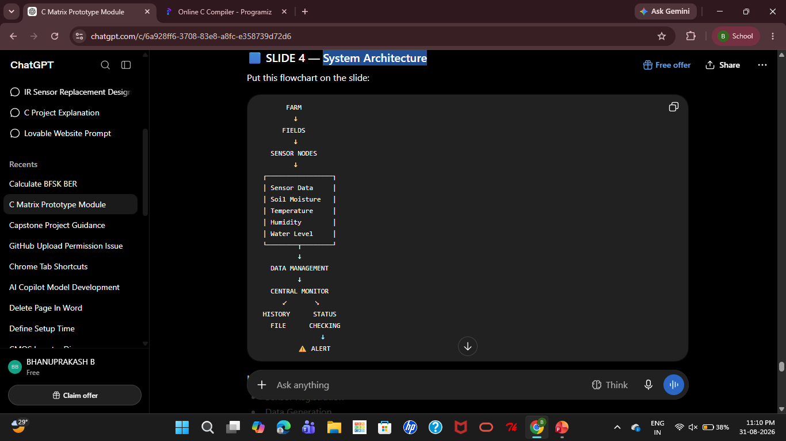
System Architecture
Key Components
Sensor Registration
Data Generation
Data Management
Historical Storage
Sensor Status Monitoring
Alert Generation

Slide 5

Functionality
Dynamic Sensor Registration
Sensor Data Monitoring
Pointer-Based Data Management
Farm Hierarchy Traversal
Data Transmission
Historical Data Storage
Inactive Sensor Detection
Automatic Alert
Field Configuration

Slide 6
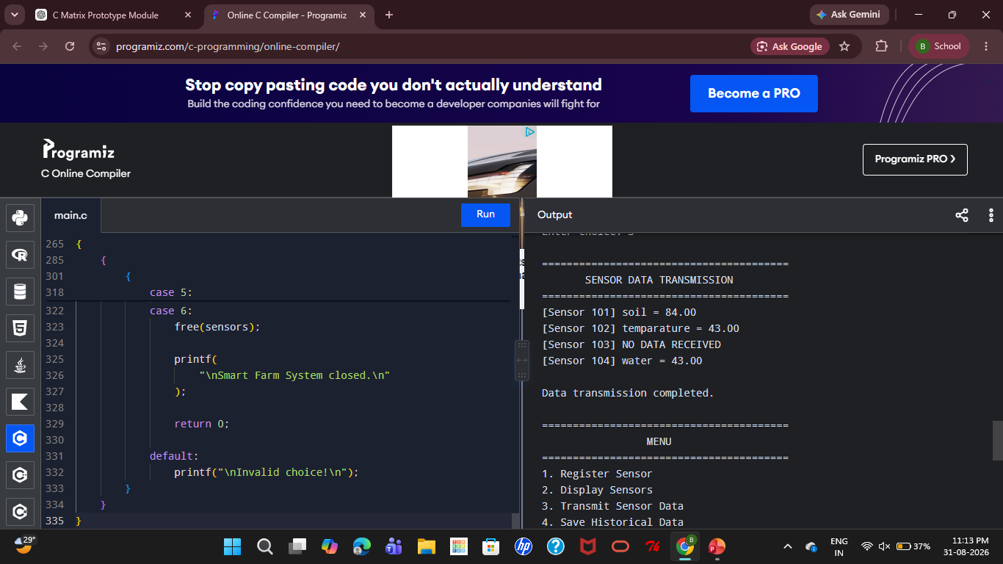
OUTPUT

Slide 7
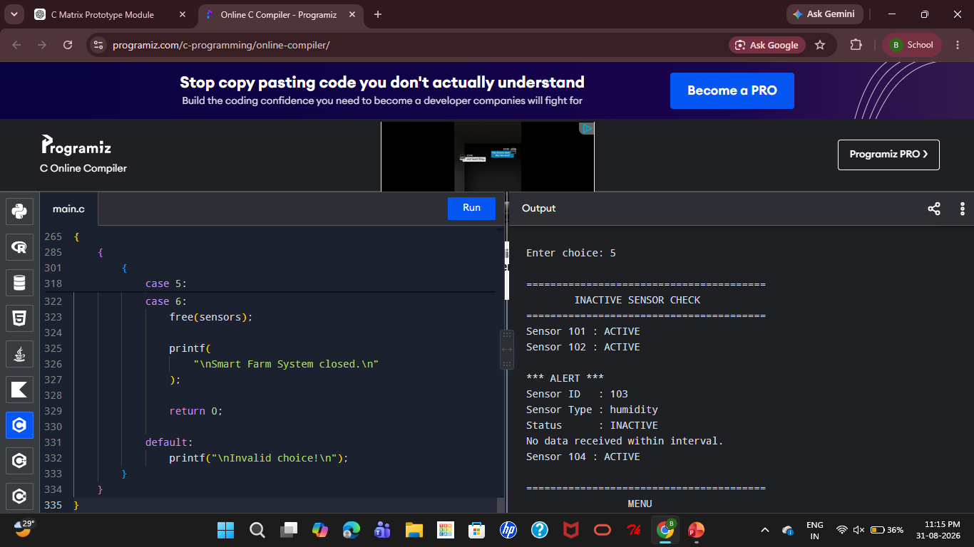
OUTPUT

Slide 8
Conclusion
Developed a Smart Farm Monitoring System using C.
Supports dynamic sensor registration and data management.
Monitors soil moisture, temperature, humidity, and water level.
Stores sensor readings for historical monitoring.
Detects inactive sensors when data is not received within the specified interval.
Automatically generates an alert for inactive sensors.
The prototype demonstrates how C programming can support scalable and automated farm monitoring.

Slide 9
References
Kernighan, B. W., & Ritchie, D. M. (1988). The C Programming Language (2nd ed.). Prentice Hall.
Stevens, W. R., Fenner, B., & Rudoff, A. M. (2003). UNIX Network Programming: The Sockets Networking API (3rd ed.). Addison-Wesley.
Butenhof, D. R. (1997). Programming with POSIX Threads. Addison-Wesley.
Tanenbaum, A. S., & Bos, H. (2014). Modern Operating Systems (4th ed.). Pearson.
Bahga, A., & Madisetti, V. (2014). Internet of Things: A Hands-on Approach. Universities Press.
Ayaz, M., Ammad-Uddin, M., Sharif, Z., Mansour, A., & Aggoune, E.-H. M. (2019). Internet-of-Things (IoT)-based smart agriculture: Toward making the fields talk. IEEE Access, 7, 129551–129583.

Slide 10
THANK YOU

